Slide 1
Business Analytics:
Data, Models, and Decisions
Lecture 2:
Introduction to R
Kai Wang
Stevens Institute of Technology
School of Business

Slide 2
R Language and R Studio
R is a statistical programming language. It is free and open source.
It is an “advanced” language compared to C, C++, Java. R typically saves your coding effort, while it is less efficient in terms of memory and time.
Competitors: Python, MATLAB, SAS, Stata, EViews, etc.
Get R installed: https://www.r-project.org/
Now, you can start using R, however, the user interface (UI) is easy to use.
R studio provides an excellent user interface.
Fet it installed: https://rstudio.com/

Slide 3
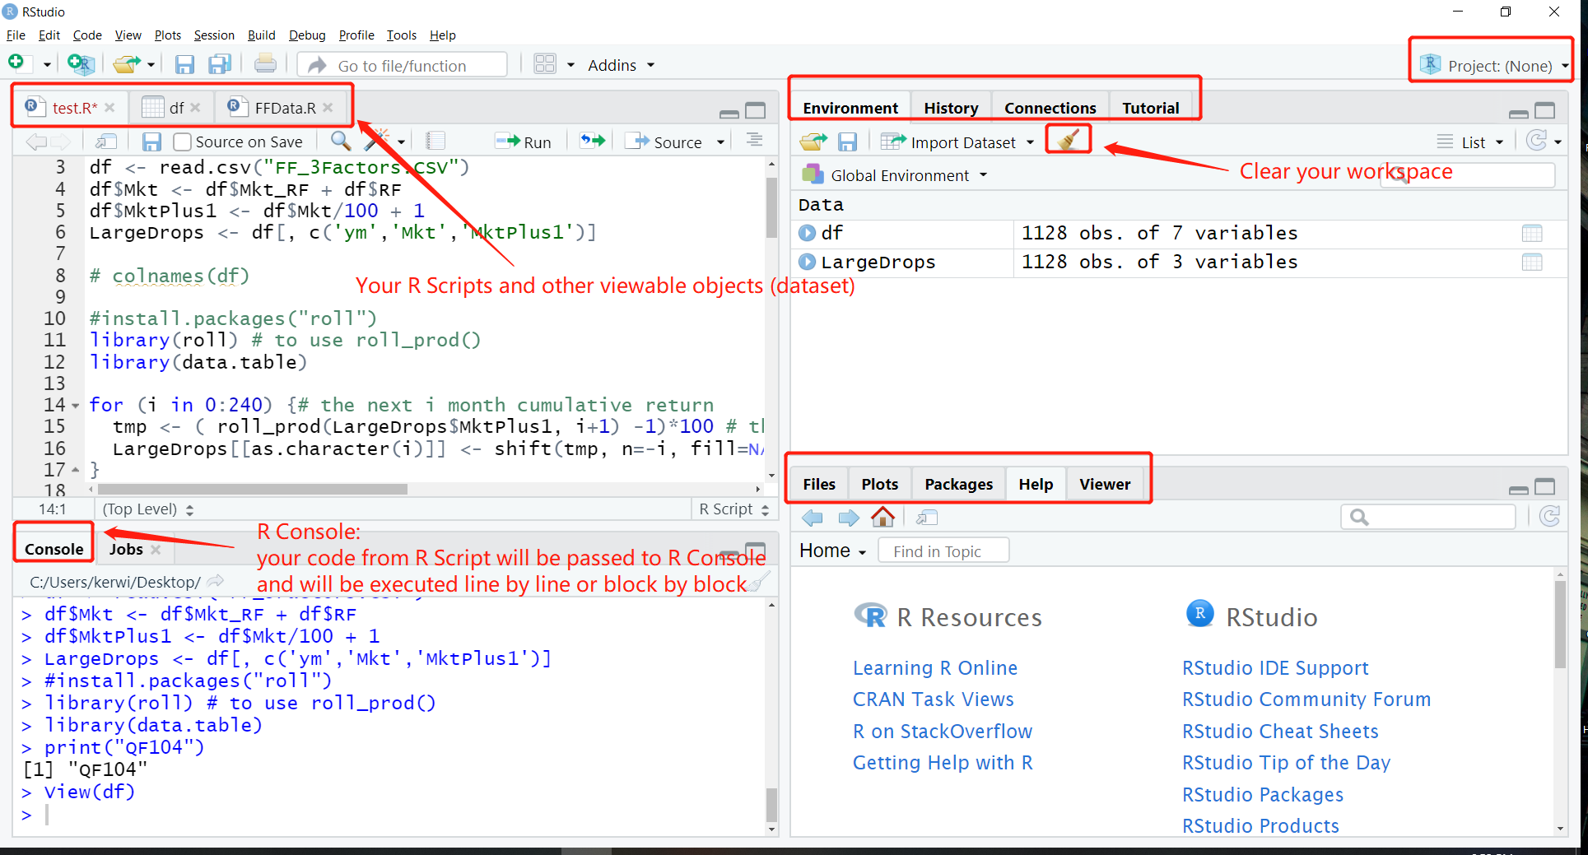
R Studio UI

Slide 4
Functions Overview
How to comment and uncomment? # or (ctrl+shift+c)
How to execute one or multiple lines of code? “Run” or (ctrl+enter)
How to assign value to a variable? Arrow (<-) or equal (=)
Note: Arrow is more recommended.
How to get more information about a function in R? help() or a question mark (?)
R compiler is case-sensitive: print() works but Print() does not work
How to shut down scientific notation? options(scipen = 999)

Slide 5
R Data Structures
Scalars: one-element vector
Vectors: one-dimensional homogeneous data (only one type [num, char, logic] of data)
Matrices: two-dimensional homogeneous data
Arrays: multi-dimensional homogeneous data
Data frames: two-dimensional heterogenous data (can have various types of data as columns)
Lists: multi-dimensional heterogenous data

Slide 6
Functions Overview (Cont.)
c() # Combine data; basic function to form a vector.
class(object) # Class or type of an object.
seq() # Generate a sequence of numbers.
matrix() # Form a matrix.
colnames(),rownames() # Column and row names.
dim(object) # Dimensions of an object.
str(object) # Structure of an object.
length(object) # Number of elements/components.
nrow(), ncol() # Number of rows and number of columns.

